Slide 1
Team & Teamwork

Slide 2
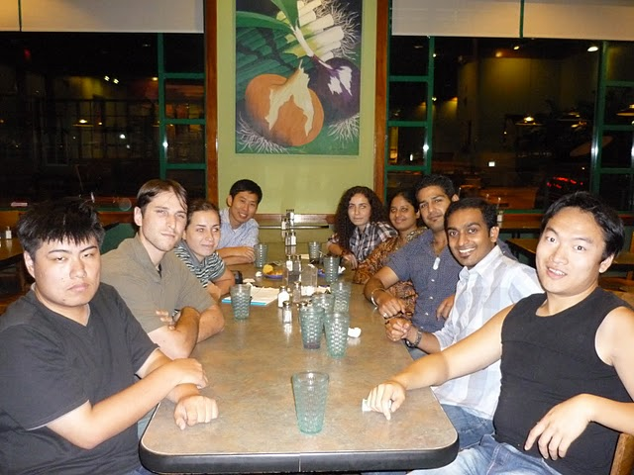
More Than Meets The Eyes!

Slide 3
Design Group
Engineering projects require diverse skills
This creates a need for group (team) work
The larger the team the more complex relationships become: n(n-1)/2
What is a team
Complementary skills
Committed to a common goal/approach
Accept accountability

Slide 4
Design Group
Models of team development
Forming – creation
Storming – develop objective
Norming - accept roles and objectives
Performing – achieve
Adjourning – success and adjourn
Select members based on skills
Technical
Problem-solving
Interpersonal

Slide 5
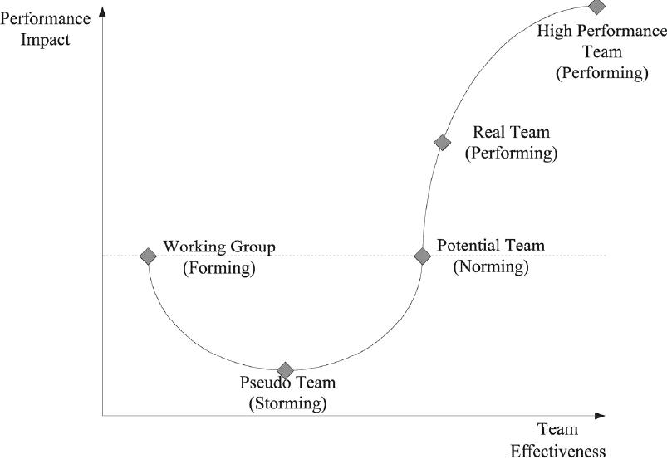
Team Performance Curve
Develop
Teamwork

Slide 6
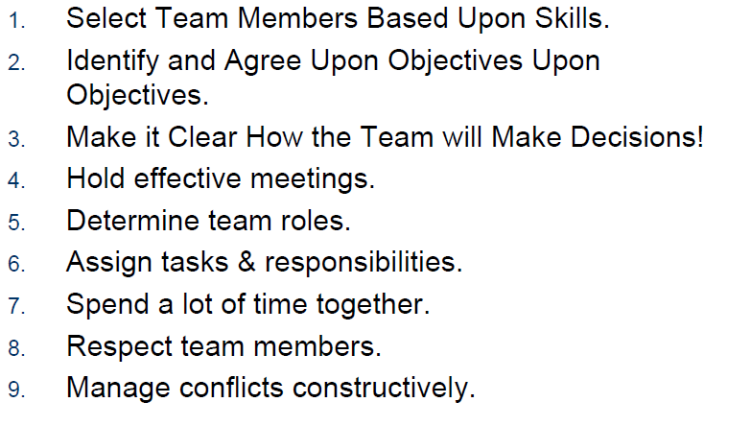
Real Team Characteristics

Slide 7
Design Group
Understand shared goals
What is success?
Develop decision making guidelines
Decision by authority (leader)
Expert Member
Average member opinion
Majority
Consensus
Normal Group Technique:
Members generate a solution; top idea wins!

Slide 8
Design Group
Teams that spend time together tend to be successful teams
Learn about each other and accent!
Respect each other
Listen actively
Consider your response to others
Constructively criticize ideas, not people
Respect those not present
Communicate your ideas effectively
Manage conflict constructively

Slide 9
Design Group
Hold effective meetings
Have an agenda
Show up prepared
Pay attention
Schedule time and place of next meeting
Summarize
Assign tasks and responsibilities
Project management

Slide 10
Design Group
Team member roles
Hardware
Software
Mechanical
Leading
Find Strengths
Leader
Recorder
Spoke person
Optimistic
Pessimistic (challenge ideas)
Analyst (how things are going)

Slide 11
Design Group
Conflict Management
Develop strategy
Listen
Mediate
Delphi Technique
Provide a solution to the mediator
Mediator makes a decision
Feedback to mediator
Revised mediator decision

Slide 12
Class Assignment
Do the survey sheet (next slide)
Develop team process guidelines:
Team’s name
Team’s mission and objectives: design problem statement
Decision making guidelines: how do you plan to finalize your decisions?
Meeting guidelines: How will you run your meetings?
Team roles: what are each team member skills?
Conflict resolution: how do you plan to resolve your conflicts?

Slide 13
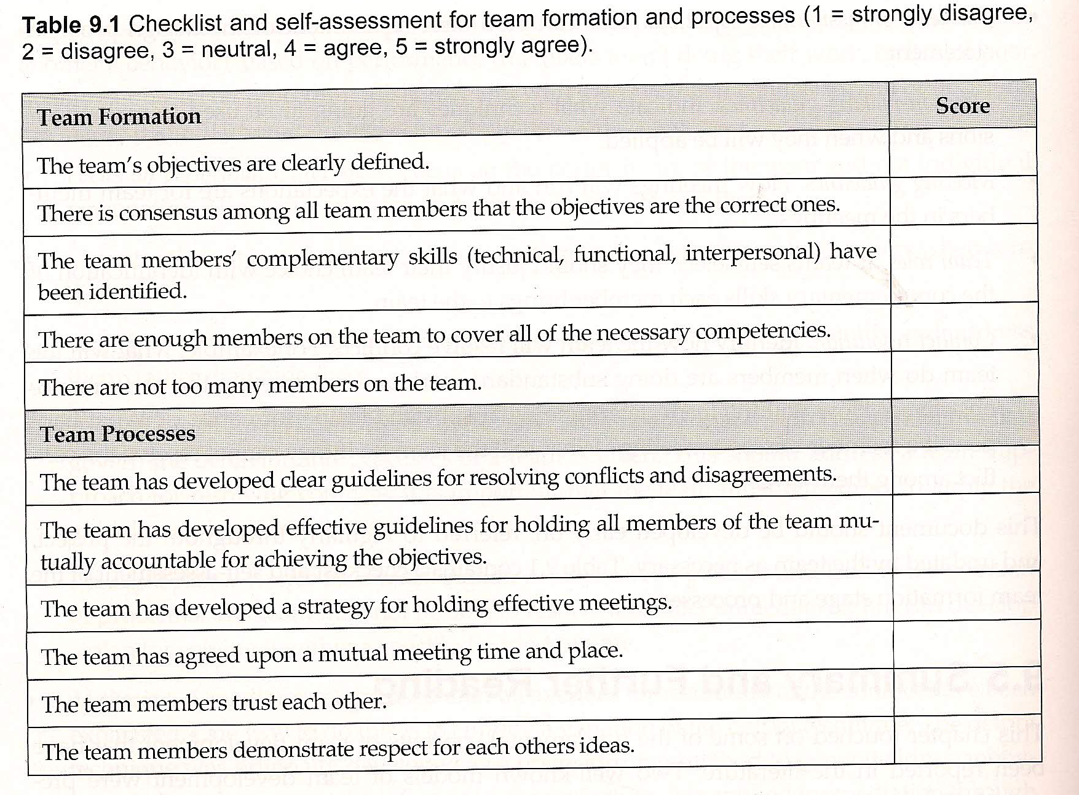

Slide 14
References
http://www.rose-hulman.edu/eceweb/ECE362/Lectures/ECE362/Smith-TPMS03.pdf : Teamwork and PRoject Management

